Slide 1

Chapter
4
The
Valuation
of
Long-Term
Securities
4.1
Van Horne and Wachowicz, Fundamentals of Financial Management, 13th edition. © Pearson Education Limited 2009. Created by Gregory Kuhlemeyer.

Slide 2
After
studying
Chapter
4,
you
should
be
able
to:
1.
Distinguish among the various terms used to express value.
Value bonds, preferred stocks, and common stocks.
Calculate the rates of return (or yields) of different types of long-term securities.
List and explain a number of observations regarding the behavior of bond prices.
2.
3.
4.
4.2
Van Horne and Wachowicz, Fundamentals of Financial Management, 13th edition. © Pearson Education Limited 2009. Created by Gregory Kuhlemeyer.

Slide 3
The
Valuation
of
Long-Term
Securities
•
Distinctions Among Valuation
Concepts
Bond Valuation
•
•
Preferred Stock
Common Stock
Rates of Return
Valuation
Valuation
(or Yields)
•
•
4.3
Van Horne and Wachowicz, Fundamentals of Financial Management, 13th edition. © Pearson Education Limited 2009. Created by Gregory Kuhlemeyer.

Slide 4
What is
Value?
•
Liquidation value represents the
amount of money that could be realized if an asset or group of assets is sold separately from its operating organization.
Going-concern value represents the amount a firm could be sold for as a continuing operating business.
Van Horne and Wachowicz, Fundamentals of Financial Management, 13th edition. © Pearson Education Limited 2009. Created by Gregory Kuhlemeyer.
•
4.4

Slide 5
What
is
Value?
•
Book value represents either:
(1)
an asset: the accounting value
of an asset – the asset’s cost minus its accumulated depreciation.
a firm: total assets minus
(2)
liabilities and preferred stock
listed on the balance sheet.
as
4.5
Van Horne and Wachowicz, Fundamentals of Financial Management, 13th edition. © Pearson Education Limited 2009. Created by Gregory Kuhlemeyer.

Slide 6
What
is
Value?
•
Market value represents the
market price at which an asset trades.
Intrinsic value represents the price a security “ought to have” based on all factors bearing on valuation.
•
4.6
Van Horne and Wachowicz, Fundamentals of Financial Management, 13th edition. © Pearson Education Limited 2009. Created by Gregory Kuhlemeyer.

Slide 7
Bond
Valuation
•
Important Terms
Types of Bonds Valuation of Bonds Handling Semiannual
Compounding
•
•
•
4.7
Van Horne and Wachowicz, Fundamentals of Financial Management, 13th edition. © Pearson Education Limited 2009. Created by Gregory Kuhlemeyer.

Slide 8
Important
Bond
Terms
•
A bond is a long-term debt
instrument issued by a corporation or government.
The maturity value (MV) [or face value] of a bond is the stated value. In the case of a US bond, the face value is usually $1,000.
•
4.8
Van Horne and Wachowicz, Fundamentals of Financial Management, 13th edition. © Pearson Education Limited 2009. Created by Gregory Kuhlemeyer.

Slide 9
Important
Bond
Terms
•
The bond’s coupon rate is the stated
rate of interest; the annual interest payment divided by the bond’s face value.
The discount rate (capitalization rate) is dependent on the risk of the bond and is composed of the risk-free rate plus a premium for risk.
Van Horne and Wachowicz, Fundamentals of Financial Management, 13th edition. © Pearson Education Limited 2009. Created by Gregory Kuhlemeyer.
•
4.9

Slide 10
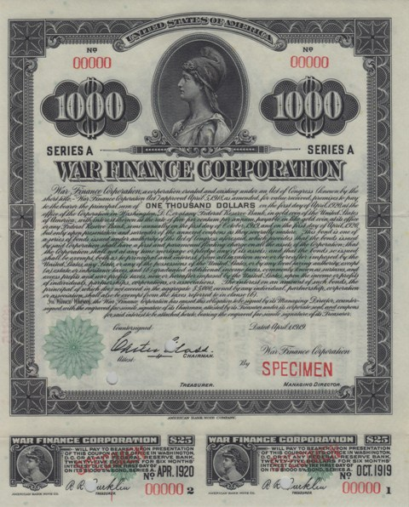

Slide 11
Different
Types
of
Bonds
A
perpetual bond is a bond that never
matures.
It
has an
infinite life.
_{V =} I ₊ I _{+ ... +} I
(1 + k_{d})¹
(1
+
k_{d})²
(1
+
k_{d})
I
=
or
I (PVIFA
)
(1 + k_{d})
t
k ,
t=1
d
V = I / k_{d}
[Reduced Form]
4.10
Van Horne and Wachowicz, Fundamentals of Financial Management, 13th edition. © Pearson Education Limited 2009. Created by Gregory Kuhlemeyer.

Slide 12
Perpetual
Bond
Example
Bond P has a $1,000 face value and
provides an 8% annual coupon. The appropriate discount rate is 10%. What
is
the value
of the perpetual
bond?
I
k_{d}
V
=
=
=
=
$1,000 (
10%.
I / k_{d}
8%)
= $80.
[Reduced Form]
$80 / 10% = $800.
Van Horne and Wachowicz, Fundamentals of Financial Management, 13th edition. © Pearson Education Limited 2009. Created by Gregory Kuhlemeyer.
4.11

Slide 13
Different
Types
of
Bonds
A non-zero coupon-paying bond
is a
life.
coupon paying bond
with
a
finite
V = ^{I} + ^{I} + ... + ^{I + MV}
_{d}
(1 + k_{d})¹
(1
+ k_{d})²
(1
+
k
)^{n}
n
I
MV
=
+
(1 + k_{d})
t
(1 + k_{d})^{n}
t=1
V = I (PVIFA _{k , n}) + MV (PVIF _{k , n})
d
d
4.13
Van Horne and Wachowicz, Fundamentals of Financial Management, 13th edition. © Pearson Education Limited 2009. Created by Gregory Kuhlemeyer.

Slide 14
Coupon
Bond
Example
Bond C has a $1,000 face value and provides
an 8% annual coupon for 30 years. The appropriate discount rate is 10%. What is the value of the coupon bond?
V
^{= $80 (PVIFA}10%,
₃₀)
+
+
^{$1,000 (PVIF}10%,
$1,000 (.057)
₃₀)
= $80 (9.427)
[Table IV]
[
[Table II]
=
=
$754.16 + $57.00
$811.16.
Van Horne and Wachowicz, Fundamentals of Financial Management, 13th edition. © Pearson Education Limited 2009. Created by Gregory Kuhlemeyer.
4.14

Slide 15
Different Types
of
Bonds
A zero coupon bond is a bond that
pays no interest but sells at a deep discount from its face value; it provides compensation to investors in the form of price appreciation.
_{V =} MV
= MV (PVIF
)
^{k}d,
n
(1 + k_{d})^{n}
4.16
Van Horne and Wachowicz, Fundamentals of Financial Management, 13th edition. © Pearson Education Limited 2009. Created by Gregory Kuhlemeyer.

Slide 16
Zero-Coupon
Bond Example
Bond Z has a $1,000 face value and a 30 year life. The appropriate discount rate is 10%. What is the
value
V
of
==
=
=
the zero-coupon
$1,000
(PVIF_{10%,30})
$1,000 (0.057)
$57.00
bond?
4.17
Van Horne and Wachowicz, Fundamentals of Financial Management, 13th edition. © Pearson Education Limited 2009. Created by Gregory Kuhlemeyer.

Slide 17
Semiannual
Compounding
Most bonds in the US pay interest
twice a year (1/2 of the annual coupon).
Adjustments needed:
(1)
(2) (3)
Divide k_{d} by 2
Multiply n by 2
Divide I by 2
4.19
Van Horne and Wachowicz, Fundamentals of Financial Management, 13th edition. © Pearson Education Limited 2009. Created by Gregory Kuhlemeyer.

Slide 18
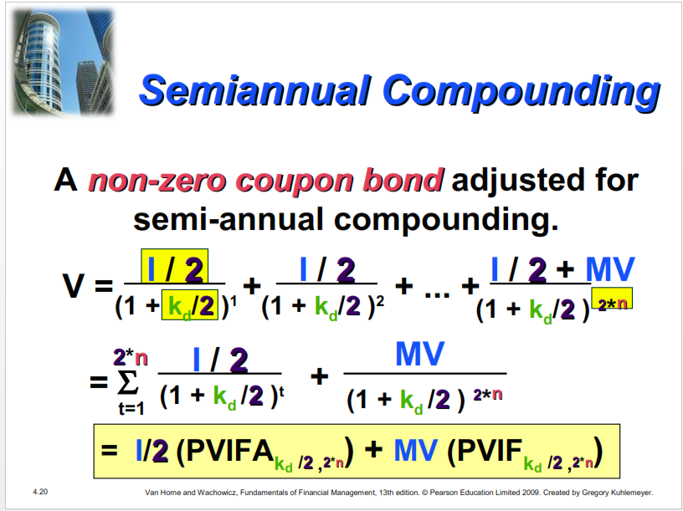
Semiannual
Compounding
A non-zero coupon bond adjusted for
semi-annual compounding.
I / 2
I / 2
I / 2 +
MV
V =
+
+ ... +
(1 +
k_{d}/2
)
1
(1
+ k_{d}/2 )
2
(1 + k_{d}/2
)
²*^{n}
2*n
I / 2
MV
=
+
(1 + k_{d} /2 )
t
(1 + k_{d} /2 )
²*^{n}
t=1
= I/2 (PVIFA_{k 2 ,2*n}) + MV (PVIF )
d
/
kd
/2
,^{2*n}
4.20
Van Horne and Wachowicz, Fundamentals of Financial Management, 13th edition. © Pearson Education Limited 2009. Created by Gregory Kuhlemeyer.

Slide 19
Semiannual
Coupon
Bond
Example
Bond C has a $1,000 face value and provides
an 8% semi-annual coupon for 15 years. The
appropriate discount rate is
What is the value of the
10% (annual rate).
coupon bond?
V
= $40 (PVIFA_{5%, 30}) + $1,000 (PVIF_{5%, 30}) = $40 (15.373) + $1,000 (.231)
[Table IV]
[
[Table II]
=
=
$614.92
$845.92
+ $231.00
4.21
Van Horne and Wachowicz, Fundamentals of Financial Management, 13th edition. © Pearson Education Limited 2009. Created by Gregory Kuhlemeyer.

Slide 20
Semiannual
Coupon
Bond
Example
Let us use another worksheet on your
calculator to solve this problem. Assume that Bond C was purchased (settlement date) on 12-31-2004 and will be redeemed on 12-31-2019. This is identical to the 15- year period we discussed for Bond C.
What is its percent of par? What is the value of the bond?
4.23
Van Horne and Wachowicz, Fundamentals of Financial Management, 13th edition. © Pearson Education Limited 2009. Created by Gregory Kuhlemeyer.

Slide 21
Semiannual
Coupon
Bond
Example
1.
What is
percent
its
of par?
•
84.628% of
(as quoted
par
in
financial papers)
2.
What is
the
•
84.628% x
$1,000 face value = $846.28
value of the
bond?
4.25
Van Horne and Wachowicz, Fundamentals of Financial Management, 13th edition. © Pearson Education Limited 2009. Created by Gregory Kuhlemeyer.

Slide 22
Preferred Stock
Valuation
Preferred Stock is a type of stock
that promises a (usually) fixed dividend, but at the discretion of the board of directors.
Preferred Stock has preference over common stock in the payment of dividends and claims on assets.
4.26
Van Horne and Wachowicz, Fundamentals of Financial Management, 13th edition. © Pearson Education Limited 2009. Created by Gregory Kuhlemeyer.

Slide 23
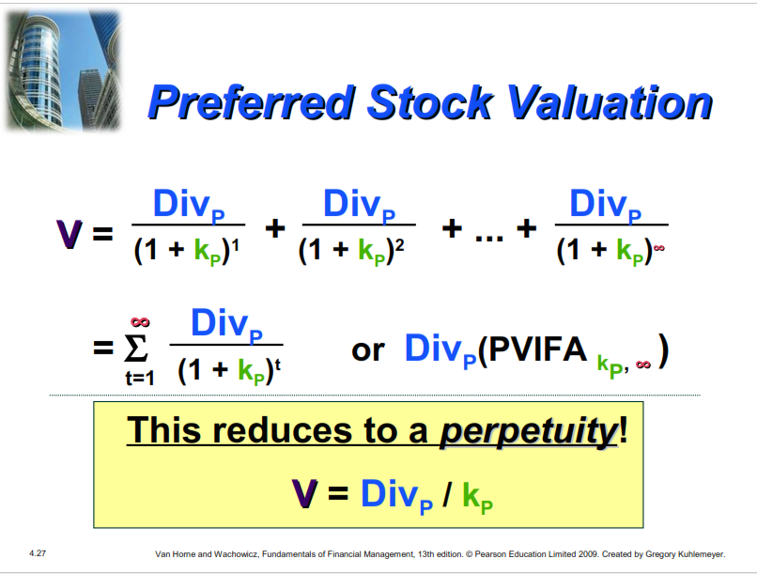
Preferred
Stock
Valuation
Div_{P}
Div_{P}
Div_{P}
V
=
+
+
... +
(1
+ k_{P})¹
(1
+ k_{P})²
(1 + k_{P})
Div_{P}
=
or Div (PVIFA
)
(1
+
k_{P})^{t}
P
^{k}P,
t=1
This reduces to a perpetuity!
V = Div_{P} / k_{P}
4.27
Van Horne and Wachowicz, Fundamentals of Financial Management, 13th edition. © Pearson Education Limited 2009. Created by Gregory Kuhlemeyer.

Slide 24
Preferred Stock
Example
Stock PS has an 8% dividend , $100 par value issue outstanding. The appropriate discount rate is 10%.
What is the value of the preferred stock?
Div_{P}
= $100 ( 8% ) = $8.00.
k_{P}
V
=
=
=
10%.
Div_{P} / k_{P} = $8.00 /10%
$80
4.28
Van Horne and Wachowicz, Fundamentals of Financial Management, 13th edition. © Pearson Education Limited 2009. Created by Gregory Kuhlemeyer.

Slide 25
Common
Stock
Valuation
Common stock represents a
residual ownership position in the corporation.
•
Pro rata share of future earnings
after all other obligations of the firm (if any remain).
Dividends may be paid out of the pro rata share of earnings.
Van Horne and Wachowicz, Fundamentals of Financial Management, 13th edition. © Pearson Education Limited 2009. Created by Gregory Kuhlemeyer.
•
4.29

Slide 26
Common
Stock
Valuation
What cash flows will a shareholder
receive when owning shares
common stock?
of
(1)
(2)
Future dividends
Future sale of the common stock shares
4.30
Van Horne and Wachowicz, Fundamentals of Financial Management, 13th edition. © Pearson Education Limited 2009. Created by Gregory Kuhlemeyer.

Slide 27
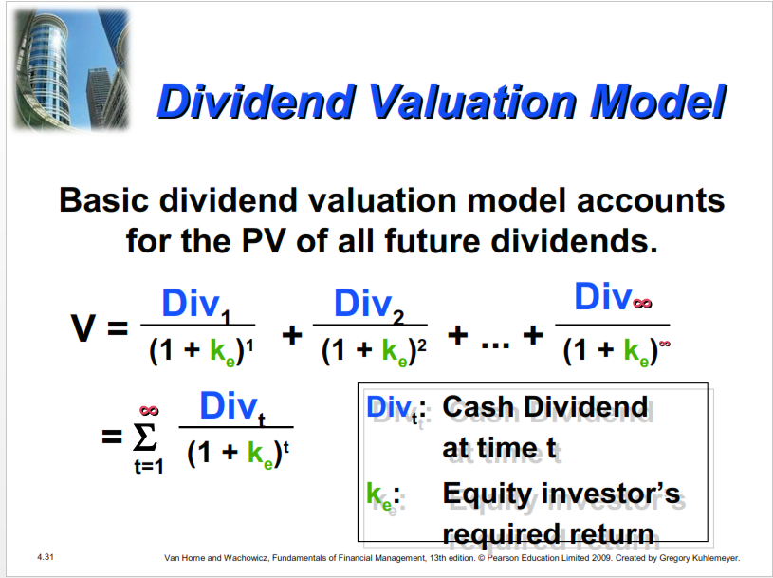
Dividend
Valuation
Model
Basic dividend valuation model accounts
for the PV of all future dividends.
Div₁
Div₂
Div
V =
+
+ ... +
(1 + k_{e})¹
(1
+
k_{e})²
(1 + k_{e})
Div_{t}
^{Div}t_{t}:
: Equity investor’s
:
Cash Dividend
at time t
=
(1 + k_{e})
t
t=1
k_{e}
:
Required Return
4.31
Van Horne and Wachowicz, Fundamentals of Financial Management, 13th edition. © Pearson Education Limited 2009. Created by Gregory Kuhlemeyer.

Slide 28
Adjusted
Valuation
Dividend
Model
The basic
adjusted
dividend valuation
model
for the future stock sale.
Div₁
Div₂
Divn + Pricen
V
=
+
+ ... +
(1
+
k_{e})¹
(1 + k_{e})²
(1 + k
)^{n}
e
nn The year n wh ch he rm’s shares are expected o be sold
Price_{nn} The expected share price n year nn
n: The year in which the firm’s
Price_{n}: The expected share price in year n.
shares are expected to be sold.
4.32
Van Horne and Wachowicz, Fundamentals of Financial Management, 13th edition. © Pearson Education Limited 2009. Created by Gregory Kuhlemeyer.

Slide 29
Dividend
Growth
Pattern
Assumptions
The dividend valuation model requires
forecast of all future dividends. The
the
following dividend growth rate assumptions
simplify the valuation process.
Constant Growth
No Growth
Growth Phases
4.33
Van Horne and Wachowicz, Fundamentals of Financial Management, 13th edition. © Pearson Education Limited 2009. Created by Gregory Kuhlemeyer.

Slide 30
Constant
Growth
Model
The constant growth model assumes that
dividends will grow forever at the rate
g.
D₀(1+g)
D₀(1+g)²
D₀(1+g)
V =
+
+ ...
+
(1 +
k_{e})¹
(1 +
k_{e})²
(1 + k_{e})
D₁
(k - g)
: Dividend paid at time 1.
g : The constant growt_{t}h_{h}rat_{t}e.. k_{e}: I_{I}nvestor’’s required Return .
D_{1 :}
1
Dividend
paid at time
1.
=
e
e
4.34
Van Horne and Wachowicz, Fundamentals of Financial Management, 13th edition. © Pearson Education Limited 2009. Created by Gregory Kuhlemeyer.

Slide 31
Constant
Growth
Model
Example
Stock CG has an expected dividend growth rate of 8%. Each share of stock just received an annual $3.24 dividend. The appropriate discount rate is 15%. What is the value of the common stock?
D₁ = $3.24 ( 1 + 0.08 ) = $3.50
V_{CG} = D₁ / ( k_{e} - g ) = $3.50 / (0.15 - 0.08 )
= $50
4.35
Van Horne and Wachowicz, Fundamentals of Financial Management, 13th edition. © Pearson Education Limited 2009. Created by Gregory Kuhlemeyer.

Slide 32
Zero
Growth
Model
The zero growth model assumes that
dividends will
grow forever
at the rate g
=
0.
D₁
D₂
D
V_{ZG}
=
+
+
... +
(1
+
k_{e})¹
(1 +
k_{e})²
(1 + k_{e})
D₁
k
D1: Diividend paid at time 1..
: Investor’s required return.
=
1
k_{e :}
e
Investor’s required return.
e
4.36
Van Horne and Wachowicz, Fundamentals of Financial Management, 13th edition. © Pearson Education Limited 2009. Created by Gregory Kuhlemeyer.

Slide 33
Zero
Growth
Model
Example
Stock ZG has an expected growth rate of
0%.
Each share of stock just received an
annual $3.24 dividend per share. The
appropriate discount rate is 15%. What
is
the value of the
common stock?
D₁
=
$3.24 ( 1 + 0 )
= $3.24
V_{ZG}
=
=
D₁ / ( k_{e} - 0 ) =
$21.60
$3.24 / (0.15 - 0 )
4.37
Van Horne and Wachowicz, Fundamentals of Financial Management, 13th edition. © Pearson Education Limited 2009. Created by Gregory Kuhlemeyer.

Slide 34
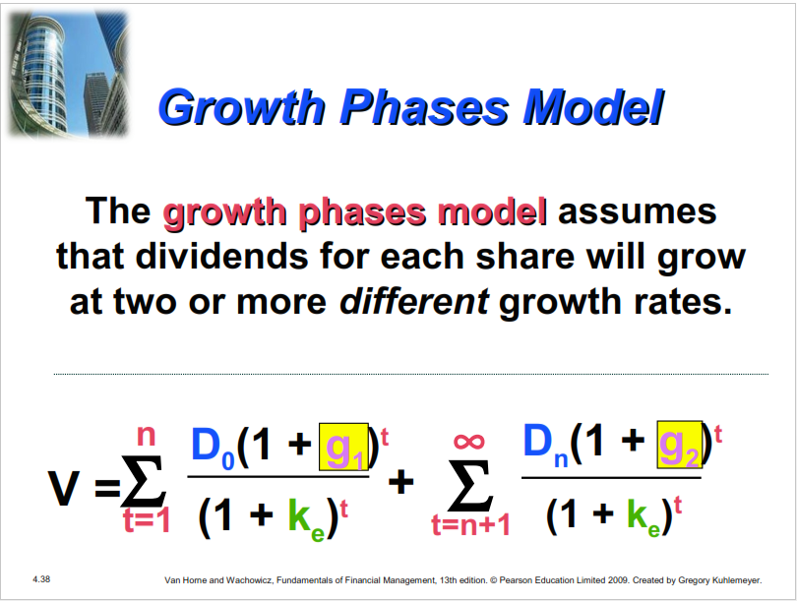
Growth
Phases
Model
The growth phases model assumes
that dividends for each share will grow
at two
or more different
growth rates.
n
D_{n}(1 + g₂)
D₀(1 + g₁)^{t}
t
₁
V
=
+
t
t=1
(1 + k_{e})^{t}
(1 + k_{e})
t=n+1
4.38
Van Horne and Wachowicz, Fundamentals of Financial Management, 13th edition. © Pearson Education Limited 2009. Created by Gregory Kuhlemeyer.

Slide 35
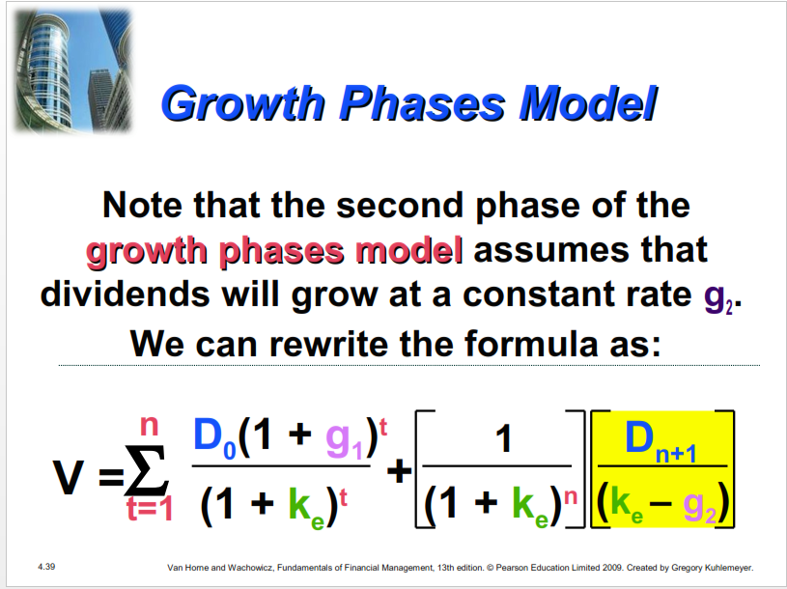
Growth Phases
Model
Note that the second phase of the
growth phases model assumes that
dividends will grow at a constant rate g₂.
We
can rewrite the formula as:
n
D₀(1 + g₁)^{t}
(
D
k_{e} – g₂)
1
+
n+1
V
=
(1 + k_{e})^{t}
(1 + k_{e})
n
(
t=1
4.39
Van Horne and Wachowicz, Fundamentals of Financial Management, 13th edition. © Pearson Education Limited 2009. Created by Gregory Kuhlemeyer.

Slide 36
Growth
Phases
Model
Example
Stock GP has an expected growth
rate of 16% for the first 3 years and
8% thereafter. Each share of stock just received an annual $3.24 dividend per share. The appropriate discount rate is 15%. What is the value of the common stock under this scenario?
Van Horne and Wachowicz, Fundamentals of Financial Management, 13th edition. © Pearson Education Limited 2009. Created by Gregory Kuhlemeyer.
4.40

Slide 37
Growth
Phases
Model
Example
0
1
2
3
4
5
6
D₁
D₂
D₃
D₄
D₅
D₆
Growth of 16% for 3 years
Growth of 8% to infinity!
S ock GP has two phases o g owth The s 16%
sta ts a time =0 o 3 yea s and s o owed by 8% the eafte sta ting a me t=3 We shou d v ew the time ne as wo sepa ate time nes n the va uation
Stock GP has two phases of growth. The first, 16%, starts at time t=0 for 3 years and is followed by 8% thereafter starting at time t=3. We should view the time line as two separate time lines in the valuation.
4.41
Van Horne and Wachowicz, Fundamentals of Financial Management, 13th edition. © Pearson Education Limited 2009. Created by Gregory Kuhlemeyer.

Slide 38
Growth
Phases
Model
Example
0 1 2 3 Growth Phase
#1 plus the infinitely long Phase #2
D₁
D₂
D₃
0 1 2 3 4 5 6
D₄ D₅ D₆
Note that we
can value
Phase #2
using the
Constant Growth Model
4.42
Van Horne and Wachowicz, Fundamentals of Financial Management, 13th edition. © Pearson Education Limited 2009. Created by Gregory Kuhlemeyer.

Slide 39
Growth
Phases
Model
Example
D₄ We can use this model because
k-g rate beginning at the end of Year 3.
V₃
=
dividends
grow
at
a
constant
8%
0 1 2 3 4 5 6
D₄ D₅ D₆
Note that
we can now replace all dividends from
year 4 to infinity with the value at time t=3, V₃!
Simpler!!
Van Horne and Wachowicz, Fundamentals of Financial Management, 13th edition. © Pearson Education Limited 2009. Created by Gregory Kuhlemeyer.
4.43

Slide 40
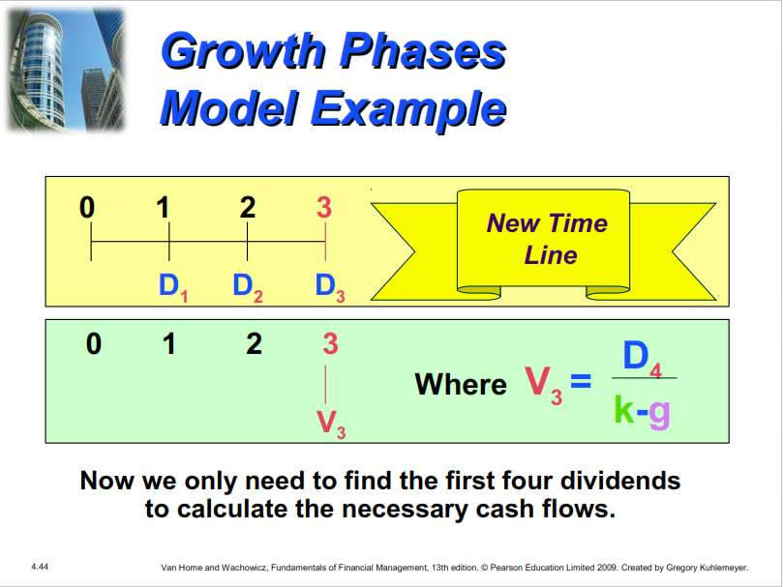
Growth
Phases
Model
Example
⁰ ¹ ² ³ New Time
Line
D₁ D₂ D₃
0 1 2 3 _{D}
3
Where V =
4
k-g
V₃
Now we only need to find the first four dividends
to calculate the necessary cash flows.
4.44
Van Horne and Wachowicz, Fundamentals of Financial Management, 13th edition. © Pearson Education Limited 2009. Created by Gregory Kuhlemeyer.

Slide 41
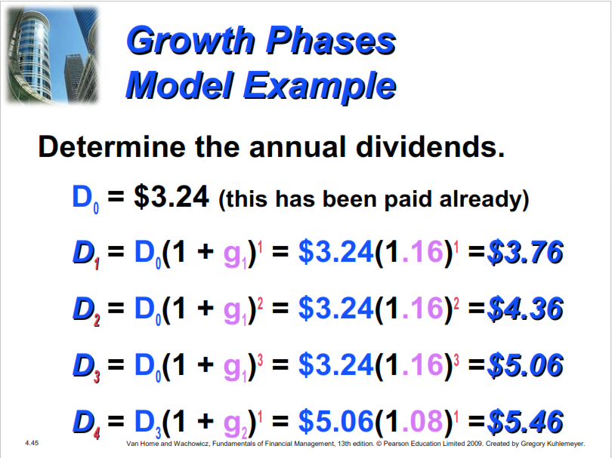
Growth
Phases
Model
Example
Determine the annual dividends.
D₀
D₁
D₂
D₃
D₄
=
=
=
=
=
$3.24 (this has been paid already)
D₀(1
D₀(1
D₀(1
+
+
+
+
g₁)¹
g₁)²
g₁)³
=
=
=
=
$3.24(1.16)¹
$3.24(1.16)²
$3.24(1.16)³
$5.06(1.08)¹
=$3.76
=$4.36
=$5.06
=$5.46
D₃(1
g₂)¹
4.45
Van Horne and Wachowicz, Fundamentals of Financial Management, 13th edition. © Pearson Education Limited 2009. Created by Gregory Kuhlemeyer.

Slide 42
Growth
Phases
Model
Example
⁰ ¹ ² ³ Actual
Values
3.76 4.36 5.06
0 1 2 3
Where $78 = 0.15–0.08
5.46
78
Now we need to find the present
of the cash flows.
value
4.46
Van Horne and Wachowicz, Fundamentals of Financial Management, 13th edition. © Pearson Education Limited 2009. Created by Gregory Kuhlemeyer.

Slide 43
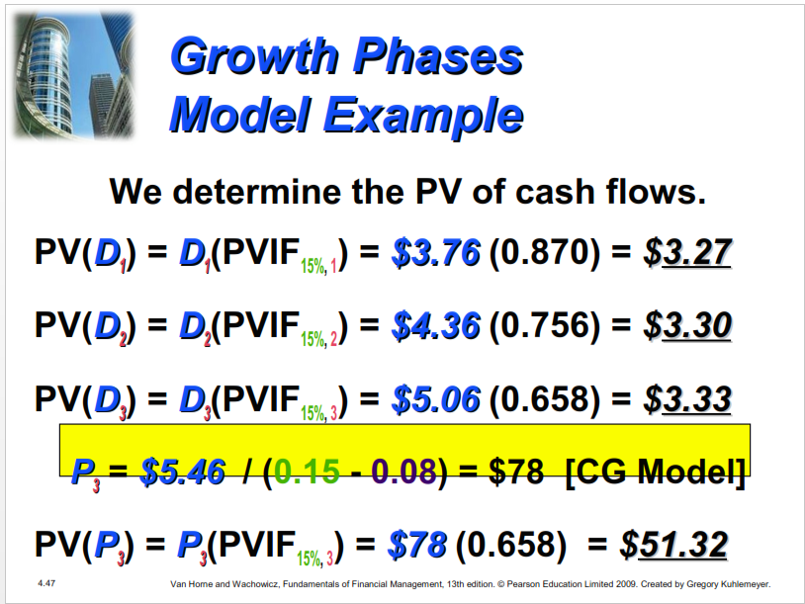
Growth
Phases
Model
Example
We determine the PV of cash
flows.
PV(D₁)
PV(D₂) PV(D₃)
=
D₁(PVIF_{15%, 1})
D₂(PVIF_{15%, 2})
D₃(PVIF_{15%, 3})
=
$3.76
(0.870)
=
$3.27
=
=
$4.36
(0.756)
=
$3.30
=
=
$5.06
(0.658)
=
$3.33
P₃ = $5.46
/ (0.15 - 0.08) =
$78
[CG Model]
PV(P₃) = P₃(PVIF_{15%, 3}) = $78 (0.658)
= $51.32
4.47
Van Horne and Wachowicz, Fundamentals of Financial Management, 13th edition. © Pearson Education Limited 2009. Created by Gregory Kuhlemeyer.

Slide 44
Growth
Phases
Model
Example
Finally, we calculate the intrinsic
value by
summing
all
of cash flow
present
values.
V
=
$3.27 + $3.30 + $3.33
+
$51.32
V =
61.22
V
=
$
³ D₀(1 +0.16)^{t}
_{t=1} (1 +0.15)^{t}
1
(1+0.15)^{n}
D
(0.15–0.08)
4
V
=
+
4.48
Van Horne and Wachowicz, Fundamentals of Financial Management, 13th edition. © Pearson Education Limited 2009. Created by Gregory Kuhlemeyer.

Slide 45
Calculating Rates
of
Return
(or
Yields)
Steps to calculate the rate
return (or Yield).
of
1.
2.
Determine the expected cash flows.
Replace the intrinsic value (V) with
the market price (P₀).
Solve for the market required rate of return that equates the discounted cash flows to the market price.
Van Horne and Wachowicz, Fundamentals of Financial Management, 13th edition. © Pearson Education Limited 2009. Created by Gregory Kuhlemeyer.
3.
4.51

Slide 46
Determining
Bond
YTM
Determine the Yield-to-Maturity
(YTM) for the annual coupon
paying
bond with
I
a finite life.
MV
n
P₀
=
+
(1 +
k_{d}
k_{d}
k_{d} )
t
(1
+
k_{d}
)^{n}
t=1
=
I (PVIFA
_{n}) +
MV (PVIF
_{n})
k
,
k
d
k ,
d
k_{d} = YTM
4.52
Van Horne and Wachowicz, Fundamentals of Financial Management, 13th edition. © Pearson Education Limited 2009. Created by Gregory Kuhlemeyer.

Slide 47
Determining the
YTM
Julie Miller want to determine the YTM
for an issue of outstanding bonds at
Basket Wonders (BW). BW has an
issue
with bonds
of 10% annual coupon bonds
15 years left to maturity. The have a current market value of
$1,250.
What is the YTM?
Van Horne and Wachowicz, Fundamentals of Financial Management, 13th edition. © Pearson Education Limited 2009. Created by Gregory Kuhlemeyer.
4.53

Slide 48
YTM
Solution (Try
9%)
$1,250
=
+
$100(PVIFA_{9%,15})
$1,000(PVIF_{9%, 15})
$1,250
=
$100(8.061) +
$1,000(0.275)
$806.10 + $275.00
$1,081.10
[Rate is too high!]
$1,250
=
=
4.54
Van Horne and Wachowicz, Fundamentals of Financial Management, 13th edition. © Pearson Education Limited 2009. Created by Gregory Kuhlemeyer.

Slide 49
YTM
Solution (Try
7%)
$1,250
=
$100(PVIFA_{7%,15})
+
$1,000(PVIF_{7%, 15})
$1,250
=
$100(9.108) +
$1,000(0.362)
$910.80 + $362.00
$1,272.80
[Rate is too low!]
$1,250
=
=
4.55
Van Horne and Wachowicz, Fundamentals of Financial Management, 13th edition. © Pearson Education Limited 2009. Created by Gregory Kuhlemeyer.

Slide 50
YTM
Solution
(Interpolate)
0.07
IRR
0.09
$1,273
$1,250
$1,081
X
$23
0.02
$192
X
$23
=
0.02
$192
4.56
Van Horne and Wachowicz, Fundamentals of Financial Management, 13th edition. © Pearson Education Limited 2009. Created by Gregory Kuhlemeyer.

Slide 51
YTM
Solution
(Interpolate)
0.07
IRR
0.09
$1,273
$1,250
$1,081
X
$23
0.02
$192
X
$23
=
0.02
$192
4.57
Van Horne and Wachowicz, Fundamentals of Financial Management, 13th edition. © Pearson Education Limited 2009. Created by Gregory Kuhlemeyer.

Slide 52
YTM
Solution
(Interpolate)
0.07
YTM
0.09
$1273
$1250
$1081
X
$23
0.02
$192
X
=
($23)(0.02)
$192
X = 0.0024
YTM
=0.07 + 0.0024
= 0.0724 or 7.24%
4.58
Van Horne and Wachowicz, Fundamentals of Financial Management, 13th edition. © Pearson Education Limited 2009. Created by Gregory Kuhlemeyer.

Slide 53
Determining
Semiannual
Coupon
Bond
YTM
Determine the Yield-to-Maturity
(YTM) for the semiannual coupon paying bond with a finite life.
2n
I / 2
MV
P₀
=
+
(1 +
k_{d}
/2
)^{t}
(1 +
k
/2
)^{2n}
t=1
d
= (I^{/2)}(PVIFAk
2_{n}) + ^{MV(PVIF}
)
,
k_{d}
, 2n
d
/2 n
^{k}d
/2
[ 1 + (k_{d} / 2)² ] –1 = YTM
4.60
Van Horne and Wachowicz, Fundamentals of Financial Management, 13th edition. © Pearson Education Limited 2009. Created by Gregory Kuhlemeyer.

Slide 54
Determining the Semiannual
Coupon Bond YTM
Julie Miller want to determine the YTM
for another issue of outstanding
bonds. The firm has
semiannual coupon years left to maturity.
an issue of 8%
bonds with 20
The bonds have
a current market value of $950.
What is the YTM?
4.61
Van Horne and Wachowicz, Fundamentals of Financial Management, 13th edition. © Pearson Education Limited 2009. Created by Gregory Kuhlemeyer.

Slide 55
Determining
Semiannual
Coupon
Bond
YTM
Determine the Yield-to-Maturity
(YTM) for
paying
the semiannual coupon
bond
with
a
finite
life.
[ (1 + k_{d} / 2)² ] –1 = YTM
[ (1 + 0.042626)² ] –1 = 0.0871
or 8.71%
Note: make sure you utilize the calculator
answer in its DECIMAL form.
Van Horne and Wachowicz, Fundamentals of Financial Management, 13th edition. © Pearson Education Limited 2009. Created by Gregory Kuhlemeyer.
4.63

Slide 56
Determining
Semiannual
Coupon
Bond
YTM
This technique will calculate k_{d}.
You
must then substitute it
into
the
following
formula.
[ (1 + k_{d} / 2)² ] –1 = YTM
[ (1 + 0.0852514/2)² ] –1 = 0.0871
or 8.71% (same result!)
4.65
Van Horne and Wachowicz, Fundamentals of Financial Management, 13th edition. © Pearson Education Limited 2009. Created by Gregory Kuhlemeyer.

Slide 57
Bond
Price
- Yield
Relationship
Discount Bond – The market required
rate of return exceeds the coupon rate
(Par > P₀ ).
Premium Bond – The coupon rate
exceeds the market required rate of
return (P₀ > Par).
Par Bond – The coupon rate equals
the
market required rate of return (P₀ = Par).
4.66
Van Horne and Wachowicz, Fundamentals of Financial Management, 13th edition. © Pearson Education Limited 2009. Created by Gregory Kuhlemeyer.

Slide 58
Bond
Price
-
Yield
Relationship
1600
1400
1200
1000
Par
600
BOND PRICE ($)
5 Year
15 Year
0
0
2
4
6
8
10
12
14
16
18
Coupon Rate
MARKET REQUIRED RATE OF RETURN (%)
4.67
Van Horne and Wachowicz, Fundamentals of Financial Management, 13th edition. © Pearson Education Limited 2009. Created by Gregory Kuhlemeyer.

Slide 59
Bond
Price-Yield
Relationship
When interest rates riserise then
the marke required rates o return risrisee and bond prices wil fallfall
When interest rates rise, then the
market required rates off return rise
and bond prices will_{l} fall.
Assume that the required
rate
of return on
a 15 year, 10% annual coupon paying bond
rises from 10% to 12%. What happens to the bond price?
4.68
Van Horne and Wachowicz, Fundamentals of Financial Management, 13th edition. © Pearson Education Limited 2009. Created by Gregory Kuhlemeyer.

Slide 60
Bond
Price
-
Yield
Relationship
1600
₅
1400
1200
1000
Par
600
BOND PRICE ($)
Year
1
15 Year
0
0
2
4
6
8
10
12
14
16
18
Coupon Rate
MARKET REQUIRED RATE OF RETURN (%)
Van Horne and Wachowicz, Fundamentals of Financial Management, 13th edition. © Pearson Education Limited 2009. Created by Gregory Kuhlemeyer.
4.69

Slide 61
Bond Price-Yield
Relationship (Rising Rates)
The required rate of return on a 15
year, 10% annual coupon paying
bond has risen from 10% to
12%.
Therefore, the bond price has
from $1,000 to $864.
($863.78 on calculator)
fallen
4.70
Van Horne and Wachowicz, Fundamentals of Financial Management, 13th edition. © Pearson Education Limited 2009. Created by Gregory Kuhlemeyer.

Slide 62
Bond
Price-Yield
Relationship
When interest rates ffaallll then the
market required rates of return fallfall and bond prices w ll risrisee
When interest rates fall, then the market required rates of return fall
and bond prices wi_{i}ll rise.
Assume that the required
rate of
return on a 15 year, 10% annual
coupon paying bond falls from 10% to
8%.
What happens to the bond price?
4.71
Van Horne and Wachowicz, Fundamentals of Financial Management, 13th edition. © Pearson Education Limited 2009. Created by Gregory Kuhlemeyer.

Slide 63
Bond
Price
-
Yield
Relationship
1600
1400
1200
1000
Par
600
BOND PRICE ($)
5
1
Year
15 Year
0
0
2
4
6
8
10
12
14
16
18
Coupon Rate
MARKET REQUIRED RATE OF RETURN (%)
Van Horne and Wachowicz, Fundamentals of Financial Management, 13th edition. © Pearson Education Limited 2009. Created by Gregory Kuhlemeyer.
4.72

Slide 64
Bond Price-Yield Relationship
(Declining Rates)
The required rate of return on a 15
year, 10% coupon paying bond has fallen from 10% to 8%.
Therefore, the bond price has
risen from $1000 to $1171.
($1,171.19 on calculator)
4.73
Van Horne and Wachowicz, Fundamentals of Financial Management, 13th edition. © Pearson Education Limited 2009. Created by Gregory Kuhlemeyer.

Slide 65
The
Role
of
Bond
Maturity
The longer the bond maturity, the greater the change in bond price for a given change in the market required rate of return
The longer the bond maturity, the
greater the change in bond price for a given change in the market required rate of return.
Assume that the required rate of return on both the 5 and 15 year, 10% annual coupon paying bonds fall from 10% to
8%. What happens to the changes in bond prices?
Van Horne and Wachowicz, Fundamentals of Financial Management, 13th edition. © Pearson Education Limited 2009. Created by Gregory Kuhlemeyer.
4.74

Slide 66
Bond
Price
-
Yield
Relationship
1600
1400
BOND PRICE ($)
1200
1000
Par
600
5
1
Year
15 Year
0
0
2
4
6
8
10
12
14
16
18
Coupon Rate
MARKET REQUIRED RATE OF RETURN (%)
Van Horne and Wachowicz, Fundamentals of Financial Management, 13th edition. © Pearson Education Limited 2009. Created by Gregory Kuhlemeyer.
4.75

Slide 67
The
Role of
Bond
Maturity
The required rate of return on both the
5 and 15 year, 10% annual coupon paying bonds has fallen from 10% to
8%.
The 5 year bond price has risen from $1,000 to
$1,080 for the 5 year bond (+8.0%).
The 15 year bond price has risen from $1,000 to
$1,171 (+17.1%). Twice as fast!
4.76
Van Horne and Wachowicz, Fundamentals of Financial Management, 13th edition. © Pearson Education Limited 2009. Created by Gregory Kuhlemeyer.

Slide 68
The
Role
of
the
Coupon
Rate
For a given change in he
marke required ra e of re urn,
he price o a bond w ll change
by proport ona ly more he
lloowewerr the coupon rate
For a given change in the market required rate of return, the price of a bond will change by proportionally more, the lower the coupon rate.
4.77
Van Horne and Wachowicz, Fundamentals of Financial Management, 13th edition. © Pearson Education Limited 2009. Created by Gregory Kuhlemeyer.

Slide 69
Example
of
the
Role of
the
Coupon
Rate
Assume that the market required rate of
return on two equally risky 15 year bonds is 10%. The annual coupon rate for Bond H is 10% and Bond L is 8%.
What is the rate of change in each of the
bond prices if market required rates fall to 8%?
4.78
Van Horne and Wachowicz, Fundamentals of Financial Management, 13th edition. © Pearson Education Limited 2009. Created by Gregory Kuhlemeyer.

Slide 70
Example
of
the Role
of
the
Coupon
Rate
The price on Bond H and L prior to the
change in the market required rate of return is $1,000 and $848 respectively.
The price for Bond H will rise from $1,000
to $1,171
The price for Bond L
$1,000 (+17.9%).
(+17.1%).
will rise from $848 to
Faster Increase!
4.79
Van Horne and Wachowicz, Fundamentals of Financial Management, 13th edition. © Pearson Education Limited 2009. Created by Gregory Kuhlemeyer.

Slide 71
Determining
the
Yield
on
Preferred
Stock
Determine the
stock with
P₀ =
yield for
preferred
an infinite life.
Div_{P} / k_{P}
Solving for k_{P} such
k_{P} = Div_{P} / P₀
that
4.80
Van Horne and Wachowicz, Fundamentals of Financial Management, 13th edition. © Pearson Education Limited 2009. Created by Gregory Kuhlemeyer.

Slide 72
Preferred
Example
Stock
Yield
Assume that the
annual dividend
on
each share of preferred stock is $10.
Each share of preferred stock is
currently trading at $100. What
yield on preferred stock?
is
the
k_{P} = $10 / $100.
k_{P} = 10%.
4.81
Van Horne and Wachowicz, Fundamentals of Financial Management, 13th edition. © Pearson Education Limited 2009. Created by Gregory Kuhlemeyer.

Slide 73
Determining
the
Yield
on
Common
Stock
Assume the constant growth model
is
appropriate. Determine the
on the common stock.
yield
( k_{e} – g )
k_{e} such that
P₀ = D₁ /
Solving for
k_{e} = ( D₁ / P₀ ) + g
Van Horne and Wachowicz, Fundamentals of Financial Management, 13th edition. © Pearson Education Limited 2009. Created by Gregory Kuhlemeyer.
4.82

Slide 74
Common
Stock
Yield
Example
Assume that the expected dividend
(D₁) on each share of common stock
is $3. Each share of common stock
is currently trading at $30 and has
expected growth rate of 5%. What the yield on common stock?
an
is
k_{e} = ( $3 / $30 ) + 5%
k_{e} = 10% + 5% = 15%
Van Horne and Wachowicz, Fundamentals of Financial Management, 13th edition. © Pearson Education Limited 2009. Created by Gregory Kuhlemeyer.
4.83

